Slide 1
The Nature of Science and The Scientific Method
Chapter 1

Slide 2
Introducing myself

Slide 3
Expectations
Respect each other
Do not talk while I am talking
Bags are to be outside the classroom
No eating in the classroom
ARRIVE ON TIME

Slide 4
Resources
Human Perspective textbook
An exercise book
A display folder to put your worksheets and assessments
Common stationery

Slide 5
Programs and Assessment Outline

Slide 6
What is Science
SCIENCE IS…..
a way in which answers related to NATURAL events are proposed
a way in which people can learn and UNDERSTAND events in the NATURAL WORLD.
based on OBSERVABLE EVENTS
a study of the NATURAL WORLD
a method of DISCOVERY and UNDERSTANDING by using a PROBLEM SOLVING process called the????

Slide 7
Interesting facts about the human body
https://www.youtube.com/watch?v=ZZhclrlQ2Eo

Slide 8
6 Steps to the Scientific Method
1. Make an observation
2. Form a hypothesis
3. Test the hypothesis
4. Collect, Organize and Analyze the Data
5. Draw Conclusions
6. Communicate the results

Slide 9
Step 1: Observations
Observations based on senses or tools
Sight, Smell, Touch etc.
Observations of natural events usually raise a question
Why did the water rise when the candle went out?
Research is usually done to help find out more about the question raised

Slide 10
Step 2: Form A Hypothesis
Based on your observation a Hypothesis is formed that tries to explain your observation or answer your question
A hypothesis tries to predict or determine the outcome of your experiment even before the experiment is done
Predictions usually stated in an “if ….. Then” statement. Ex: If I drop a rock then it will fall down toward the ground
HYPOTHESIS MUST BE TESTABLE!

Slide 11
Step 3: Test the Hypothesis
Controlled Experiments are used to test a hypothesis
A controlled experiment is an experiment that tests only one factor at a time by
a control group is compared with an experimental group. Variables are not changed in the Control Group.
Control groups allows you to see if a change in a variable creates an observed outcome by comparing the control group with the exp gp
A variable is a factor that changes in a controlled experiment. Variables are changed in the Exp Group AND SERVE AS THE FACTOR TESTED

Slide 12
VARIABLES
INDEPENDENT
The variable being changed in the experiment
DEPENDENT
The variable that responds to the changed independent variable
The variable being measured
EX: growing plants with different amounts of fertilizer

Slide 13
Step 3 Continued
Scientists try to design experiments that will clearly show whether a particular VARIABLE caused an observed outcome
IF IT CANNOT BE OBSERVED THEN IT CANNOT BE TESTED!!!
Can we test if a comet impact kill the dinosaurs? Why or Why Not?
Sometimes models are used to represent a real object
Used when it is difficult to control all of the variables or not possible to test “the real thing”

Slide 14
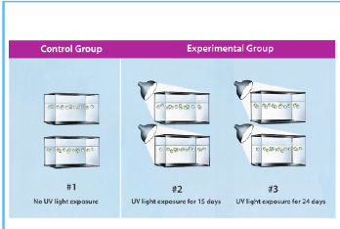
Variables are not
Changed in C.G.
One Variable Changed in
Each Exp. Group

Slide 15
Step 4: Collect, Organize & Analyze Data
Data collected from experiments
Data is defined as: recorded observations or measurements (qualitative = description, quantitative = number data)
Based on observations
Utilize tools or senses: sight, smell, temperature change etc.
Data is organized in tables, charts and graphs so that it can be more easily analyzed

Slide 16
Common graphs
Line graphs – used when continuous data is being represented.
Bar and column graphs – when discrete data is being presented
Histogram – usually presents data that shows frequencies.

Slide 17
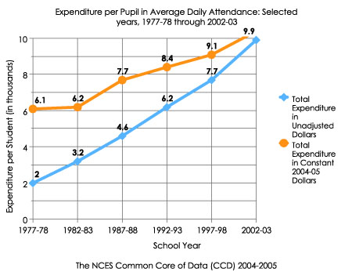

Slide 18
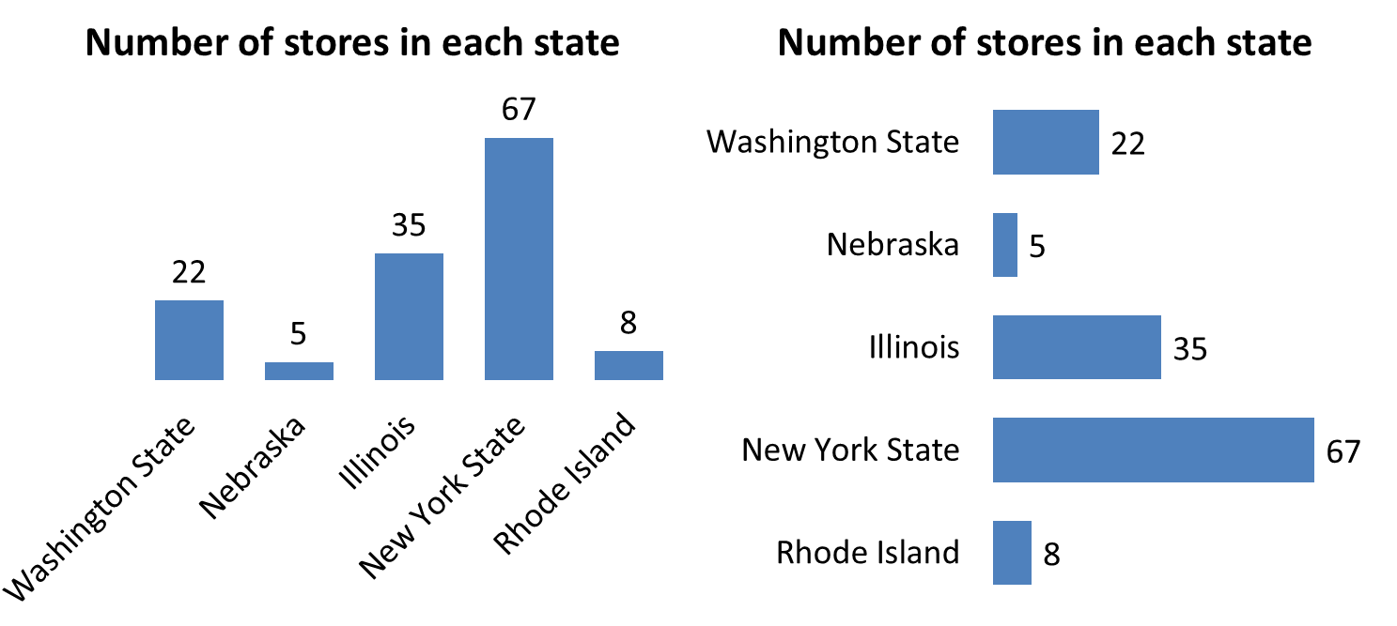

Slide 19
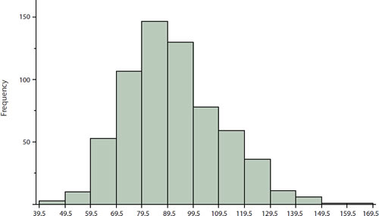

Slide 20
Step 5: Interpreting the data
Scientists decide whether the results of the experiment support a hypothesis.
When the hypothesis is not supported by the tests the scientist must find another explanation for what they have observed
NO EXPERIMENT IS A FAILURE: All experiments are observations of real events

Slide 21
Step 6: Communicate the Results
Results must be communicated in the form of a written paper or presentation
Communication helps other scientists performing the same experiments to see if the results of your experiment are the same as their results
Helps people see if results are repeatable!

Slide 22
Step 7: Evaluating the experiment
This step involves reflecting on the results and the methods of the experiment
This can be determined using VAR:
Validity of the methods – the extent to which an experiment tests what it is supposed to test
Accuracy of the results
Reliability of the results

Slide 23
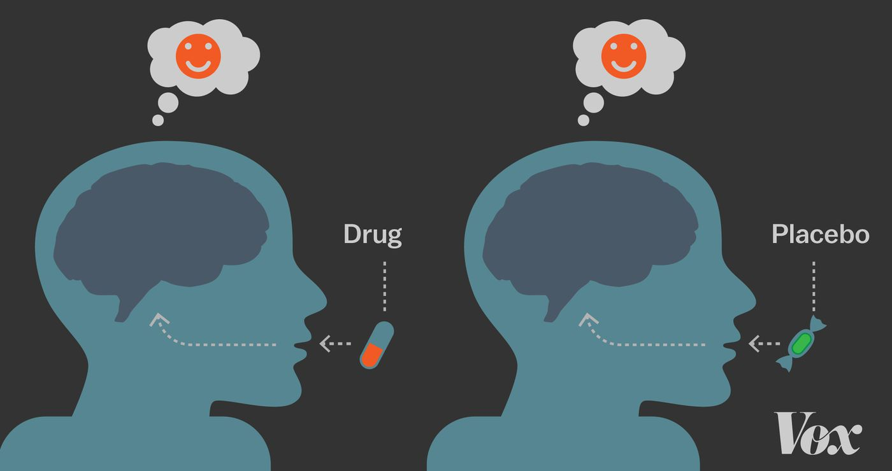
Placebos
A placebo is an inactive substance that looks like the real medication.
Commonly used in medicinal-based investigations
Experimental group will take the actual medication, while control will take the placebo
Its not rare for patients to see an improvement in their condition after taking a placebo – placebo effect
Blind and double-blind experiments

Slide 24
Placebo effect video
https://www.youtube.com/watch?v=z03FQGlGgo0

Slide 25
Experimental errors
parallax error – occurs when the measurement of an object's length is more or less than the true length because of your eye being positioned at an angle to the measurement markings.
Reading errors – differences in the reading of a measurement device (e.g. ruler) resulting in different estimations
Instrument errors – faultiness in an instrument which will never the give the right readings
Human reflex – everyone has different reflex times, resulting in different readings
Zero error – when an instrument does not read zero when nothing is on it

Slide 26
Ethics in science
In every experiment, the following ethical standards need to be met:
Voluntary participation
Eliminate or minimised the risk of harm
Confidentiality
Anonymity – stronger guarantee than confidentiality (They remain completely anonymous to all parties)

Slide 27
Theories
Theories are explanations for some phenomena based on observation, experimentation, and reasoning.
BASED ON MANY EXPERIMENTS
Experiments that explain a theory MUST be repeatable
You must be able to predict from a theory

Slide 28
LAWS
Laws are summaries of many experimental results and observations
Laws are not the same as theories because laws tell only what happens, not why it happens.

Slide 29
Pure Science
PURE SCIENCE
Pure Science: An attempt to learn more about the world or the continuing search for scientific knowledge.
pure science is done by scientists or people with inquisitive minds
involves experimentation, observations, questioning and research
involves technology

Slide 30
Technology
Technology: An application of science to meet the needs of society
engineers, inventors and creative people apply scientific knowledge to build new “things” or tools
new technology can lead to new scientific discoveries
ex: we could not learn about cells before the invention of the microscope
Question: How does science lead to new technology and how does technology add to our scientific understanding of the natural world?

